Slide 1
ALLIANCE OF EUROPEAN UNIVERSITIES WP3 LEADER PRESENTATION

Slide 2
WP 3 Leader - University of Crete
Center of Infrastructure Technology Services Informatics & Communications
Kossioris Georgios, Vice Rector of Academic Affairs, Lifelong Learning, International Relations & Outlook, Professor of Mathematics & Applied Mathematics
Pavlidis Michail, Vice-Rector for Research & Development, Professor of Biology
Argyros Antonis, Head of the Department and Professor of Computer Science,
Chalkiadakis Georgios, Deputy Director of the University’s Center of Infrastructure Technology Services Informatics & Communications
INGENIUM Alliance of European Universities – Erasmus-EDU-2022-EUR-UNIV-2 | Project number: 101090042
Notes:
UoC Persons-of-Inresrest
UoC Head of INGENIUM Project, faculty
UoC Head of ICT, faculty
UoC Head of CSD, faculty
UoC Head of Info Systems dpt., staff

Slide 3
WP Hosting Environment
ICT UoC Infrastructure & Services
electronic mail
Institute
accounts
Telephony
Web Hosting
40.000 mailboxes
18,5 ΤΒ mailboxes
Averaging 60.000 messages daily
1.817 devices
220 Voicemail
260 Fax
120 telemetry apps
~300 web sites and apps
58.000 LDAP accounts
Virtual Machines
Wired Network
WiFi Network
6 Controllers
615 Access Points
eduroam & other networks
2 FO Rings (Gallos- Voutes campuses)
105 Distribution Cabinets
185 Router-switches
7.000 outlets
Comput Infastructure
296 VM’s
1.100 vCPU
1.980 GB vRAM
Voutes DataCenter
29 Servers GRNET (Provisional) 19 Servers
200 TB Storage
Backup System
500 ΤΒ Backups on tapes
INGENIUM Alliance of European Universities – Erasmus-EDU-2022-EUR-UNIV-2 | Project number: 101090042
Notes:
Existing ICT UoC infrastructure
- We provide hardware and network recourses (in excess) to get the job done
- more resources are due (through gov & research funding)
- ICT staff is properly trained

Slide 4
WP eLearning platform (LMS)
UoC has an extensive experience and technical expertise in designing and implementing eLearning services
ICT Center with a dedicated Department for Educational Technologies
Experience gained through the design and development of:
eLearning platform supporting the University’s courses since 2006 more than 2.000 e-courses and 20.000 users
eLearning platform for the Lifelong Learning Center of the UoC EU and national projects.
Most recent eLearning platforms:
Adriseismic project, Interreg ADRION
Climademy project, Erasmus+, platform under development
Biotalent project, Erasmus+
eLearning platform to support the free OpenCourses project
INGENIUM Alliance of European Universities – Erasmus-EDU-2022-EUR-UNIV-2 | Project number: 101090042
Notes:
ICT UoC eLearning Platforms offered ( running )
ICT unit (department) doing just that…
Sufficient IT staff having on-the-job experience
Sufficient hard & soft resources
Digital media production cabinets (2) on campus
UI / Graphics Designers on staff

Slide 5
WP Information Systems support & Development
UoC Info Systems Dpt.
Provides support (among others) for Management, Financial & HR Information systems Student registry & supplementary applications Platforms and apps in dpts & units 25,000 Students, 2,000 users
Developed Student Dorms platform (2 Housing facilities) , Erasmus+ applications platform, Student housing and transportation applications platform(~2,500 applications per semester) , Research Ethics Committee platform & - Public Cord Blood Bank of Crete registry (Haemopoiesis Lab, University Hospital) - Idiopathic thrombocytopenic purpura (ITP) registry (25 hospitals, ) - Severe chronic neutropenia (Neutro) registry (Haematology Dpt., University Hospital), 2 EU states, 1 NON-EU State - Melanoma registry (University Hospital Surgical Oncology Dpt.) - European Accreditation Council for Bariatric Surgery, EAC-BS (IFSO European Chapter) (until 2018), ~58,000 records, 19 EU States, 4 NON-EU States, 49 Institutes …
INGENIUM Alliance of European Universities – Erasmus-EDU-2022-EUR-UNIV-2 | Project number: 101090042
Notes:
ICT UoC Support & Develop
ICT unit doing identical work
Supplementary apps and modules developed in house
Stand alone Platforms developed on disperse subjects
Financial, academic, administrative, scientific registries
International collaborations

Slide 6
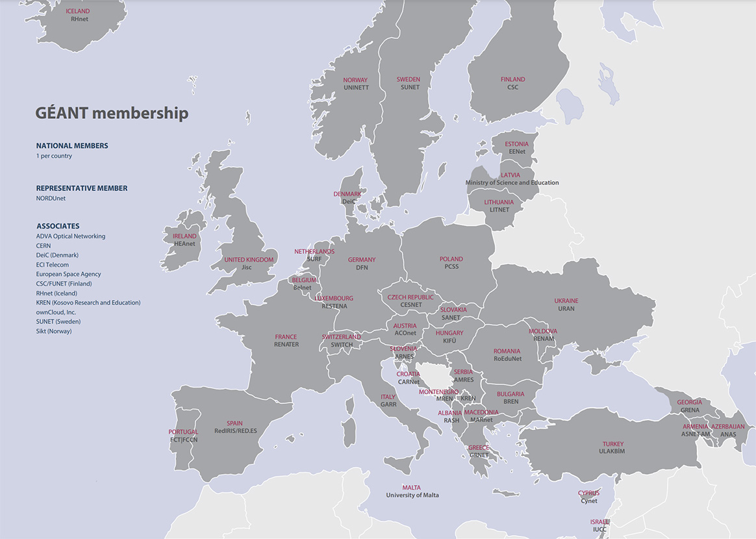
GÉANT Network
European National Research and Education Networks (NRENs).
INGENIUM Alliance of European Universities – Erasmus-EDU-2022-EUR-UNIV-2 | Project number: 101090042
Notes:
GeANT Project
National NRENs
Basis for user authentication and validation
Multi-level grants & permissions
Conesus needed on how-to ( LDAP branch created/used )

Slide 7
WP 3 main objectives
Development of the INGENIUM IT infrastructure as the basic platform and primary communication and dissemination instrument of the European University Alliance.
Facilitation of the interoperability and collaboration among the members of the Alliance.
The General Idea
Create a hospitable environment
Provide the right tools and digital facilities
Make it happen…
INGENIUM Alliance of European Universities – Erasmus-EDU-2022-EUR-UNIV-2 | Project number: 101090042
Notes:
WP Targets – Objectives
Global (top) front-end UI ( web site ) drill down to all deliverables
Authenticated landing sub-pages leading to levels down
Customizable sub levels

Slide 8
The WP tasks defined
Digital Framework: Alliance Digital State Analysis
Detail records of current digital state and needs of each member of the Alliance
Moderated Repository & Data ware house
Create and configure the main all-purpose WP repository
INGENIUM Website Development
Portal to steering committee, Administrators, IT staff and General public
INGENIUM Platforms Implementation
Educational, Administrative, Technical
*** Help Desk support will be available
INGENIUM Alliance of European Universities – Erasmus-EDU-2022-EUR-UNIV-2 | Project number: 101090042
Notes:
UOC ICT tasks ( deliverables )
Record – inform on current status
Develop, configure (on consensus) deliverables
Follow priorities and time tables
Submit and provide training and support
Help desk provision during and after submission

Slide 9
WP How-To’s & Challenges
Implement a master plan for deliverable's development.
Time line of deliverable’s progress and submission
Establish a time schedule for all parties involved.
- Regular IT Staff & Administrators meetings and conferences
- Proposals to steering committee
Record and report ( Logs & notes registry )
- Incompatibilities among members
- Delays ( technical and Administrative )
- Administrative decisions needed
- Regular reports to the Steering Committee
INGENIUM Alliance of European Universities – Erasmus-EDU-2022-EUR-UNIV-2 | Project number: 101090042
Notes:
WP dire straits
Time table to be followed
Upon agreement with all parties involved
Development time line
Prioritized
Logging and reports to steering committee
General public moderated

Slide 10
WP implementation
Digital Framework: Alliance digital state analysis
- IT’s anlysis for digital state of each member
Authentication & Validation Process
- All Members of the Alliance common validation system
Moderated Repository
- Design and development of the media and documents repository
INGENIUM website
- CMS, Responsive, Disability friendly, User authentication
INGENIUM Platforms
- Integration of educational, administrative platforms
INGENIUM Alliance of European Universities – Erasmus-EDU-2022-EUR-UNIV-2 | Project number: 101090042
Notes:
WP implementing by UoC ICT
design, implement, configure, support
ICT departments and tasks

Slide 11
WP top-down master-plan
IT directors work group
- Top level technical decisions
WP’s leaders work group
- Technical and Administrative actions implementation
Implement Ticketing system.
- Record requests and actions (2B) taken.
Establish a collaboration platform.
- Unified process for document and media exchange
Time table of all requirements
- Detailed time table with deadlines
INGENIUM Alliance of European Universities – Erasmus-EDU-2022-EUR-UNIV-2 | Project number: 101090042
Notes:
WP Planning
People involved
primarily IT staff
Keep record
ticketing system
Cloud work platform

Slide 12
WP Prerequisites
Appoint person(s)-of-contact ( each member of the Alliance )
- Technical, Administrative
In depth analysis of current digital state and future needs.
- State, propose & upgrade insufficiencies of a member
- Possibly prevent any delays due to lack of digital means
Expedite Funding for additional computing resources needed
- New IT staff employment
- Additional Computing resources needed
Prioritize Administrative decisions required
- Facilitate process of common decisions needed among members
- Inform members of what-this-is-about
INGENIUM Alliance of European Universities – Erasmus-EDU-2022-EUR-UNIV-2 | Project number: 101090042
Notes:
UOC ICT Prereqs to be met
People to talk-to acquittance
Firm initial analysis
Diagnose difficulties
Priorities set
Decisions to take

Slide 13
WP Work plan for year 1 (2023)
March 2023
- Existing web site ( DNS names ) transferred to UoC
- IT’s departments consensus on time master plan and deliverables
- Proclamation of WP3 IT positions
June 2023
- Initial Repository submission
- Consensus on validation system ( Authentication – Authorization )
September 2023
- Consensus on web site platform ( CMS )
- Consensus on Educational Platform ( LMS )
December 2023
- Initial Repository up & running - Web site (Draft SCHEMA)
INGENIUM Alliance of European Universities – Erasmus-EDU-2022-EUR-UNIV-2 | Project number: 101090042
Notes:
WP UoC ICT
- YEAR (1) deliverables into production state

Slide 14
Thank you
INGENIUM Alliance of European Universities – Erasmus-EDU-2022-EUR-UNIV-2 | Project number: 101090042

